Slide 1
3-coloring and 3-clique-ordering of locally connected graphs
Martin Kochol
Journal of Algorithms 54 (2005) 122–125
Presented by Jian-Fu Dong

Slide 2
Abstract
We present a linear algorithm for 3-coloring of locally connected graphs.

Slide 3
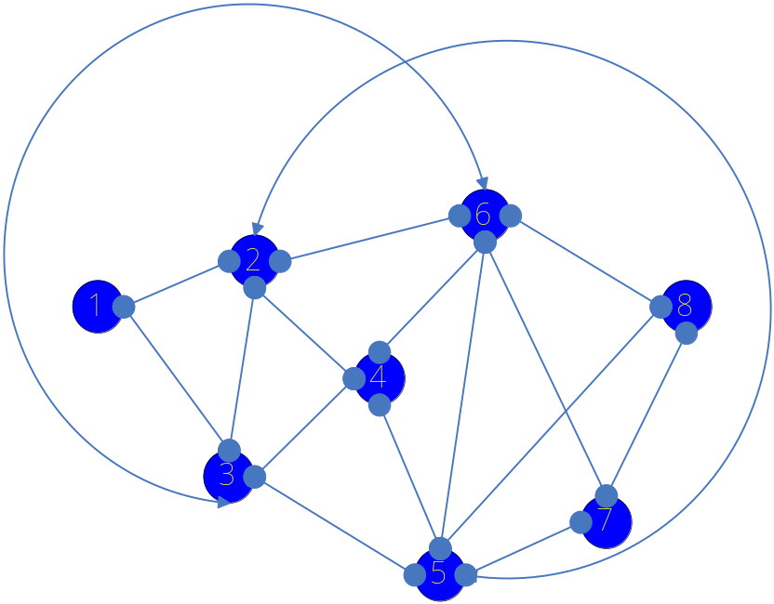
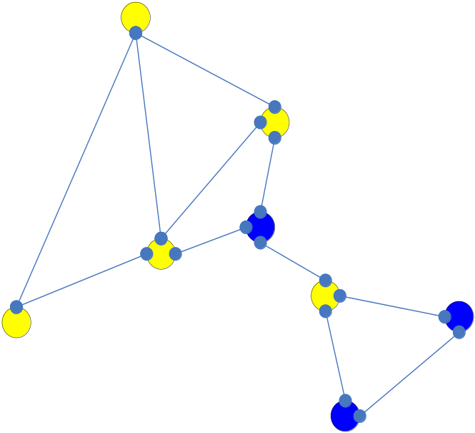
Definition(1)
N_{G}(v) :the set of vertices adjacent to v.
G is locally connected if G[N_{G}(v)] is connected for every v V(G).

Slide 4
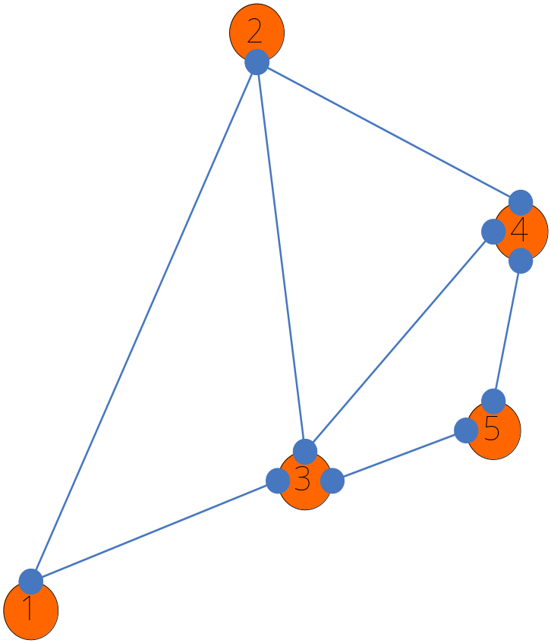
Definition(2)
r-clique-ordering of a graph G : an ordered set (v₁,…,v_{n}), n=|V(G)|, of its vertices such that for every r ≦ i ≦n, the graph G[{v₁,…,v_{i}}] contain an r-clique K_{r} covering v_{i}

Slide 5
Lemma
Lemma 1: Let G be a connected and locally connected graph. The we can find a 3-clique ordering of G in O(|E(G)|) time.

Slide 6

Definition(3)
V_{i}：a 3-clique order set (v₁,…, v_{i}) of G
H_{i}：a bipartite graph induced by the edges having exactly one end in V_{i}
W_{i}：partition of H_{i} , W_{i} V_{i}
U_{i}： partition of H_{i} , U_{i} V(G)\ V_{i}
w_{i}：a distinguished vertex of W_{i}
W_{i}’：N_{G}(w_{i}) ∩W_{i}
U_{i}’：N_{G}(w_{i}) ∩U_{i}
H_{i}’：H_{i} [W_{i}’∪U_{i}’]

Slide 7
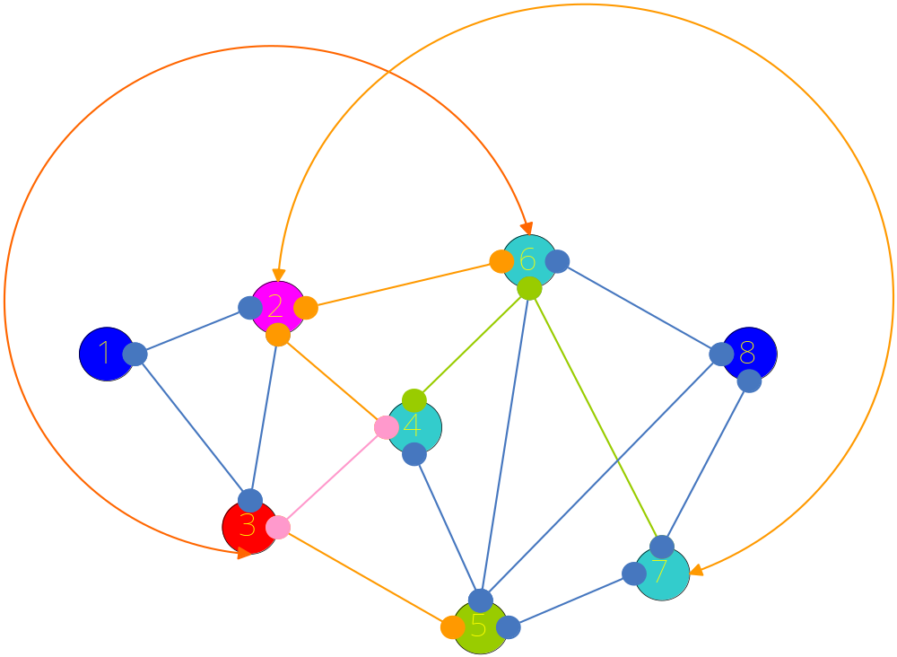
First Step
V₃ ：v₁ , v₂ , v₃
W₃ ：v₂ , v₃
U₃ ：v₄ , v₅ ,v₆ , v₇
w₃ ：v₂
W₃’：v₃
U₃’：v₄ , v₆ , v₇

Slide 8
Select v_{i}
For every 3 < i≦n, we choose a vertex v_{i} from U_{i−1} such that there is an edge v_{i}v_{i}’ from H_{i−1}. Adding v_{i} to V_{i−1} we get V_{i} .
V_{i} is a 3-clique-ordering of G[V_{i}], because V_{i−1} is a 3-clique-ordering of G[V_{i−1}] and w_{i−1}, v_{i}, v_{i}’ ∈ V_{i} induce a triangle.

Slide 9
Construct H_{i} from H_{i−1}
for each x ∈ NG(vi ):
  • If x ∈ V_{i−1} (i.e., x ∈ W_{i−1}), delete edge xv_{i} from H_{i} ; furthermore if v_{i} is the only neighbor of x in H_{i−1}, delete x from W_{i} .
  • If x /∈ V_{i−1}, add xvi to H_{i} ; furthermore if x /∈ U_{i−1}, add x to U_{i} .
If v_{i} has degree 0 in H_{i} after all these changes, delete v_{i} from H_{i} , otherwise move vi from Ui to W_{i} .
No changes are made for x and xv_{i} if x /∈ NG(v_{i} ). Thus H_{i} can be constructed in O(|NG(v_{i})|) time.

Slide 10
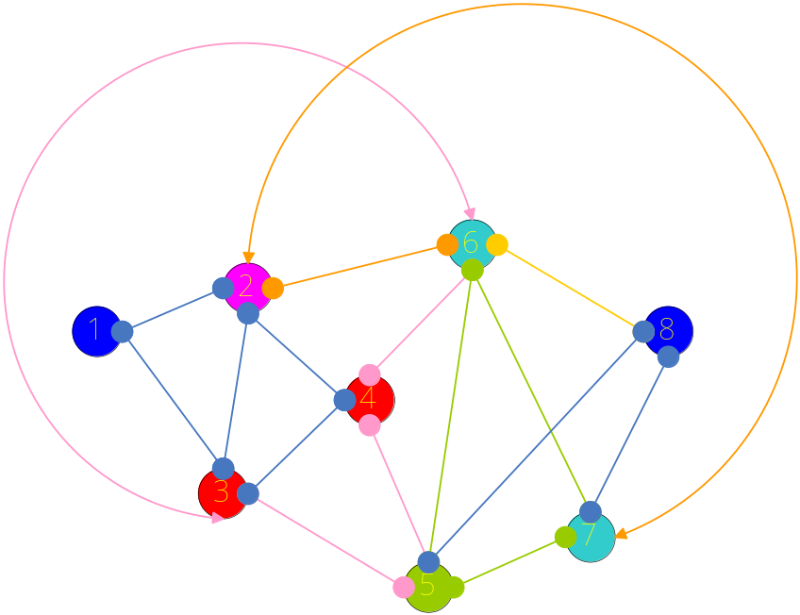
After Step 1
V₄ ：v₁, v₂, v₃, v₄
W₄ ：v₂, v₃, v₄
U₄ ：v₅, v₆, v₇
w₄ ：v₂
W₄’：v₃, v₄
U₄’：v₆, v₇

Slide 11
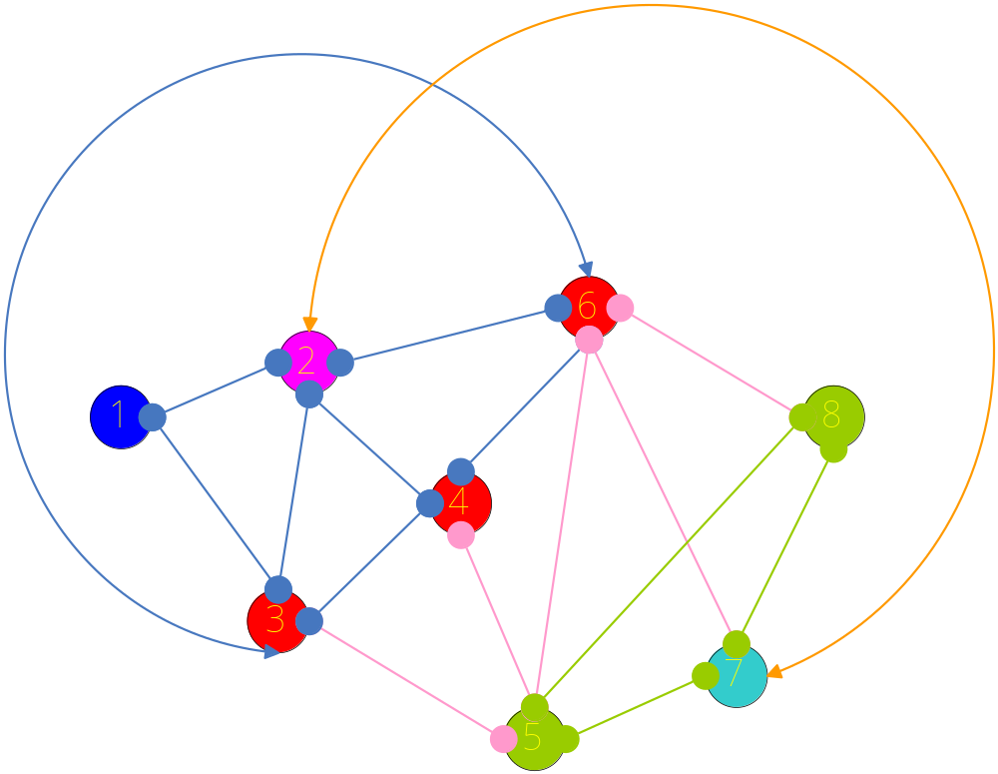
After Step 2
V₅ ：v₁, v₂, v₃, v₄ , v₆
W₅ ：v₂, v₃, v₄ , v₆
U₅ ：v₅, v₇, v₈
w₅ ：v₂
W₅’：v₃, v₄, v₆
U₅’：v₇

Slide 12
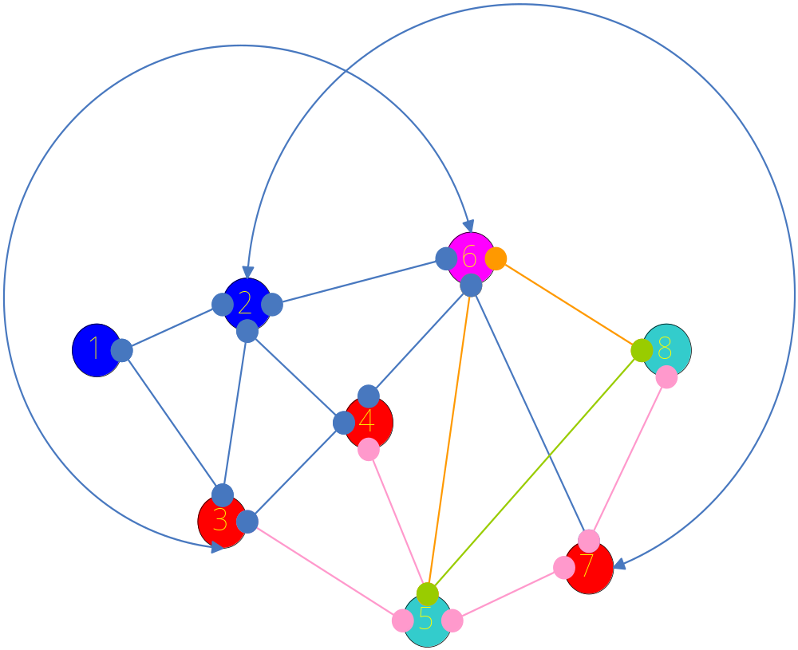
After Step 3
V₅ ：v₁, v₂, v₃, v₄ , v₆, v₇
W₅ ：v₃, v₄, v₆ , v₇
U₅ ：v₅, v₈
w₅ ：v₆
W₅’：v₃, v₄, v₇
U₅’：v₅, v₈

Slide 13
Theorem
Let G be a locally connected graph. Then in O(|V (G)| + |E(G)|) time we can either find a 3-coloring of G or indicate that G is not 3-colorable. Furthermore, if G is 3-colorable, then every component of G is uniquely 3-colorable.

Slide 14
Conclusion
This theorem cannot be generalized to k-colorability for k > 3 unless P = NP.
Proof : construct for any connected graph G a locally connected graph G_{n}, adding to G a copy of K_{n} and joining every vertex from G with every vertex from K_{n}. Then G_{n} is n + r-colorable if G is r-colorable.
=>k-coloring of locally connected graph is NP-complete for any k >3.

